Slide 1
Install CPLEX On Linux Using VirtualBox
TA: Yu-Min Shen
Advisor: Shao-Yun Fang
The Electronic Design Automation Laboratory
Department of Electrical Engineering
National Taiwan University of Science and Technology
Notes:
主要是將還沒達到delay constraint的net做detour，達到讓每個group 的 net arrival time基本都滿足timing constraints。

Slide 2
Outline
Download CPLEX
Install VirtualBox on Windows
Implement CPLEX on Virtual Machine

Slide 3
Download cplex

Slide 4

Register Account
Link: https://www.ibm.com/academic/topic/data-science
click here

Slide 5
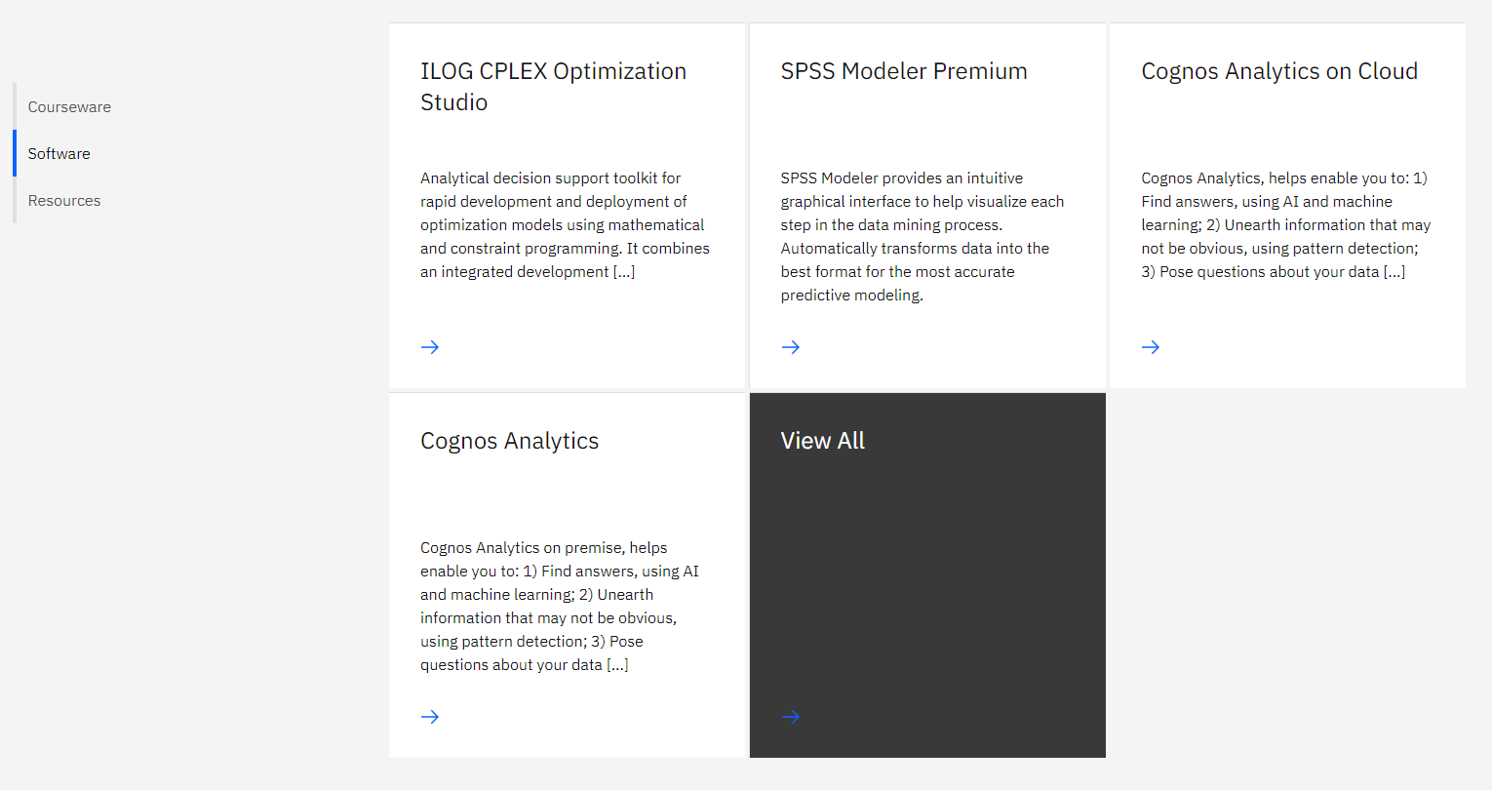
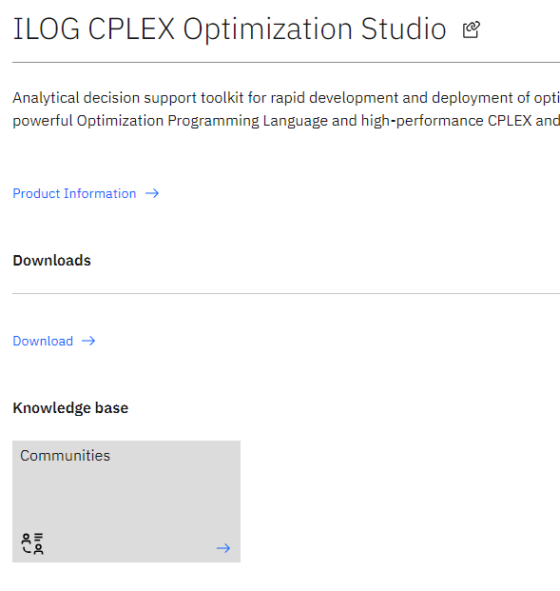
Find CPLEX
Scroll down the page to find CPLEX
1
2
3

Slide 6
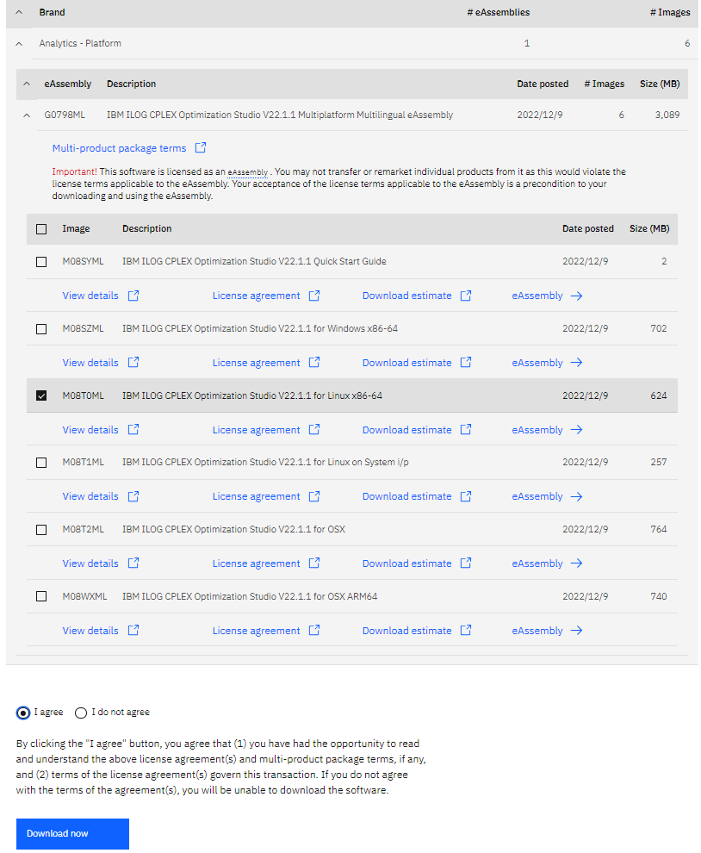
Download CPLEX

Slide 7
Install virtualbox on windows
If you have already installed virtual machine, you can skip this part and move to Page 17.

Slide 8
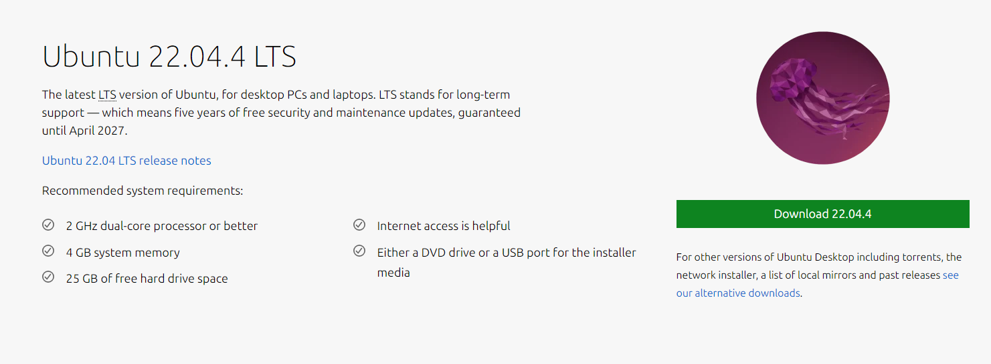
Download Ubuntu
Link: https://ubuntu.com/download/desktop
click here

Slide 9
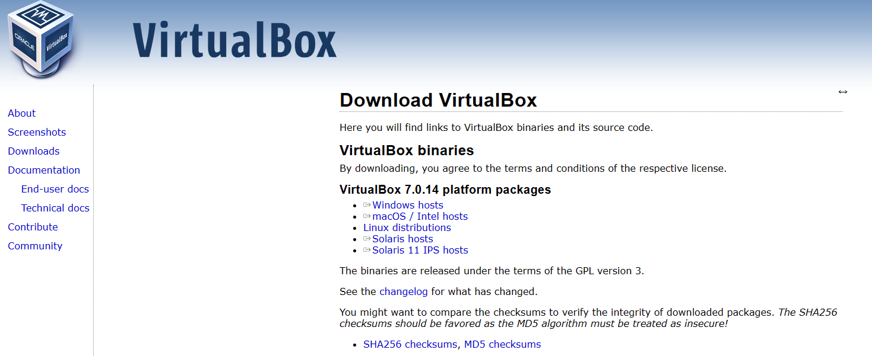
Download VirtualBox
Link: https://www.virtualbox.org/wiki/Downloads
click here
Notes:
由於高速應用的發展，package的 timing spec變得越來越重要，使得我們delay-matching是一個很重要的考量(也就是每個group的net的arrival time應該要一致)。
那由於之前沒有work針對advance package做delay matching，像是複雜的routing rule以及越來越嚴重的congestion，都會讓計算變得越來越複雜，所以本篇就提出了可以處理advance package delay-matching的問題。

Slide 10
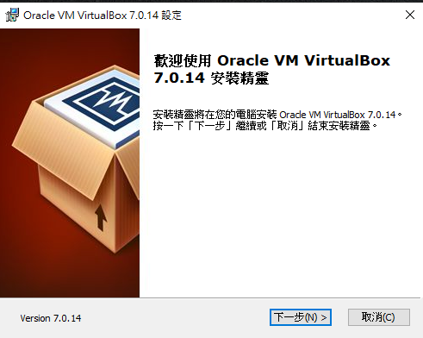
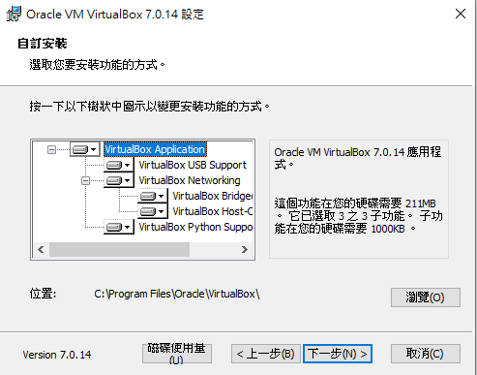
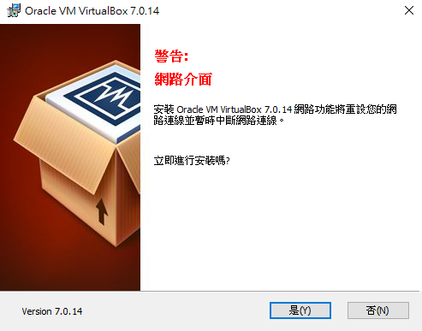
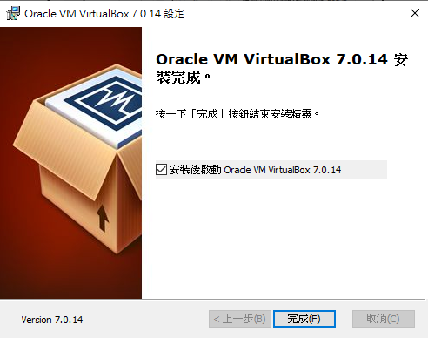
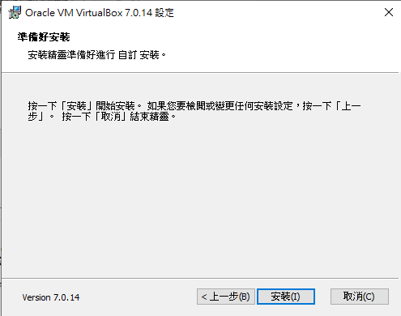
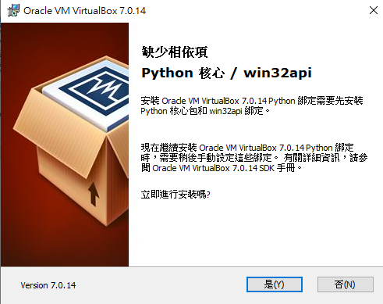
Install VirtualBox

Slide 11
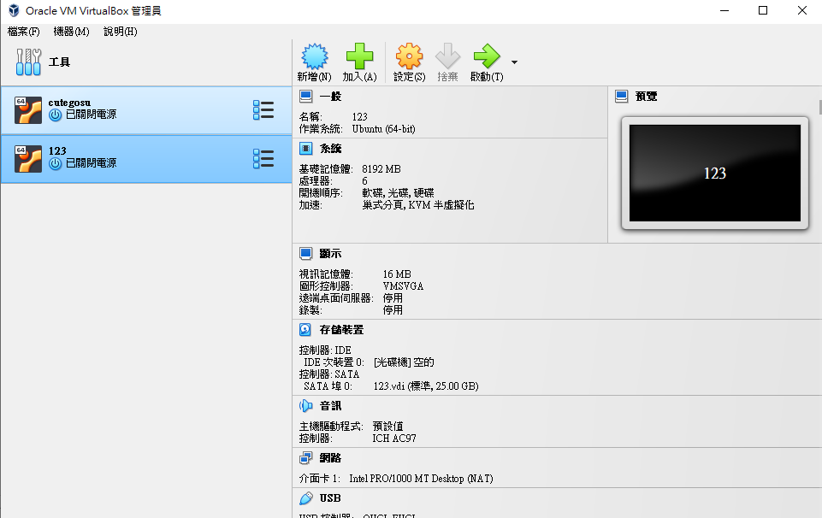
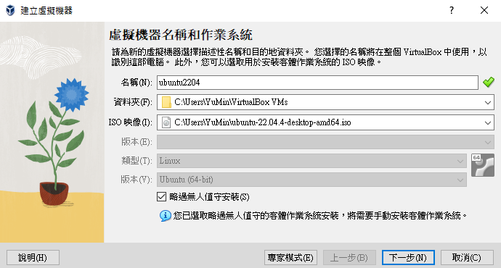
Create Account on VirtualBox
click here
Specify the ubuntu.iso you have downloaded before

Slide 12
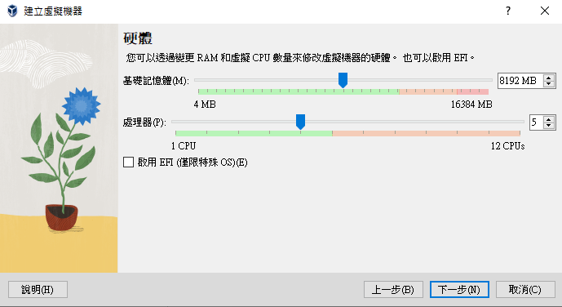
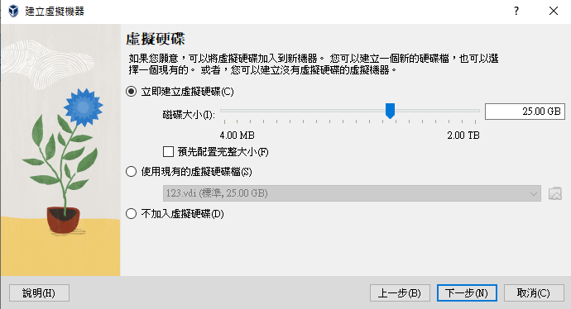
Allocate Resource for VMBox
Share the half number of RAM and Core is enough.

Slide 13
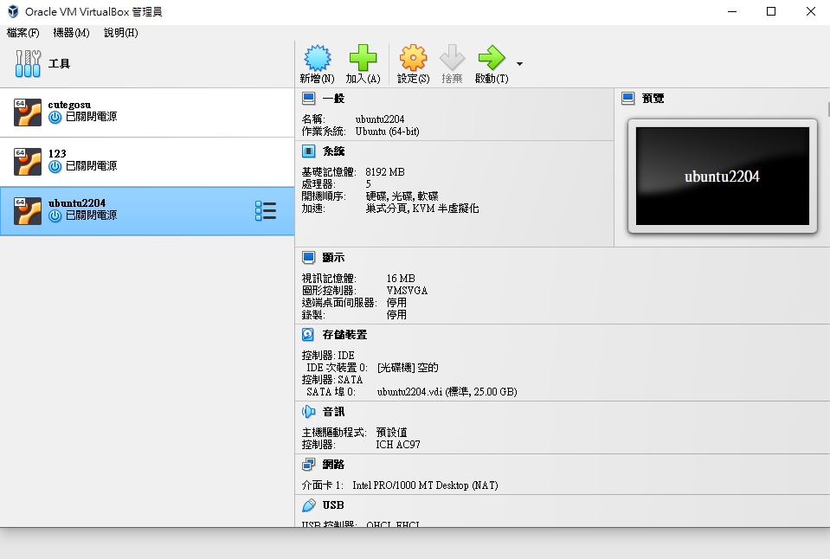
Open the Linux System
Once done the setting of the virtual machine, we can start it.
click here

Slide 14
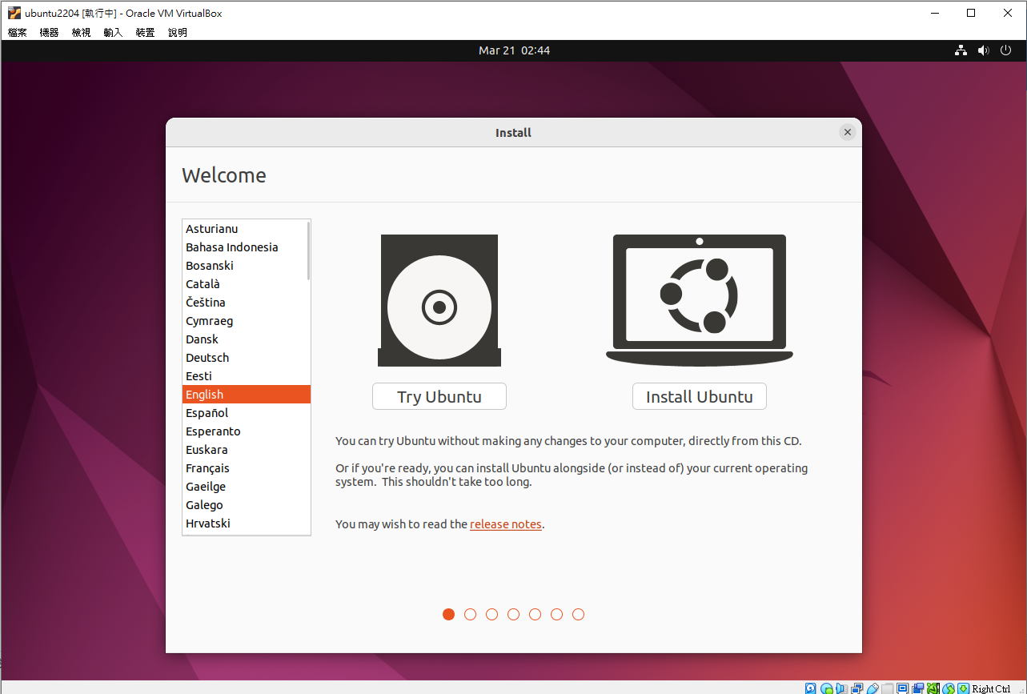
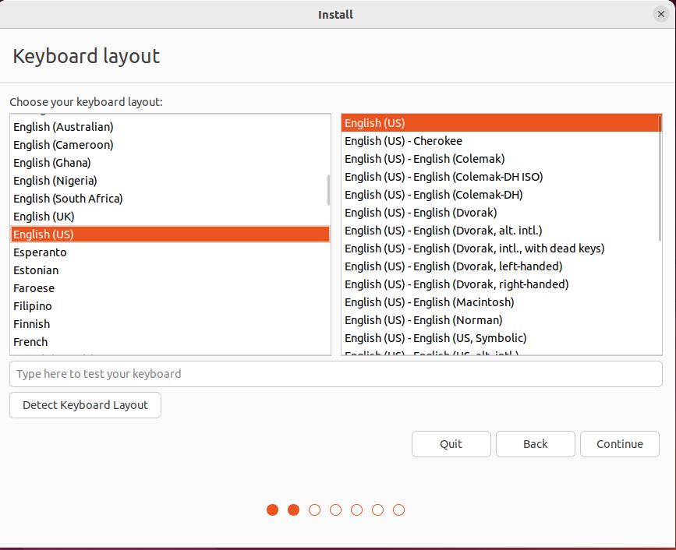
Set Environment(1/3)

Slide 15
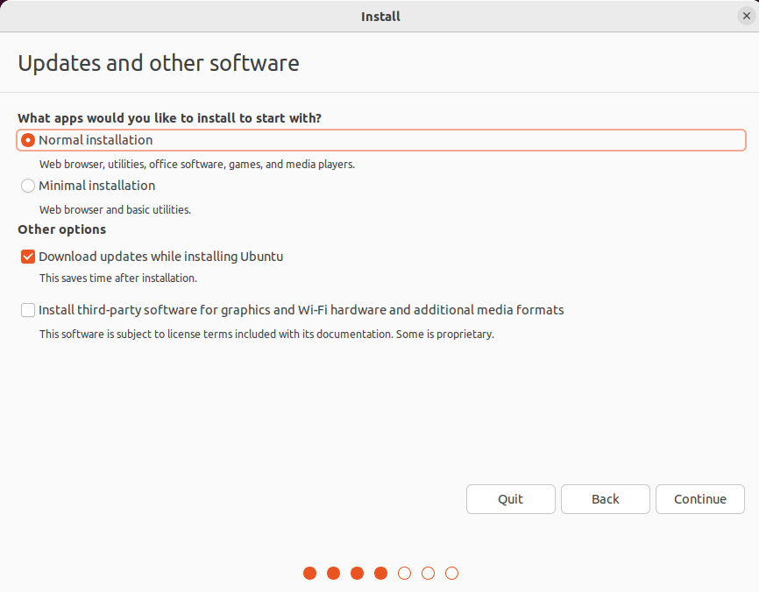
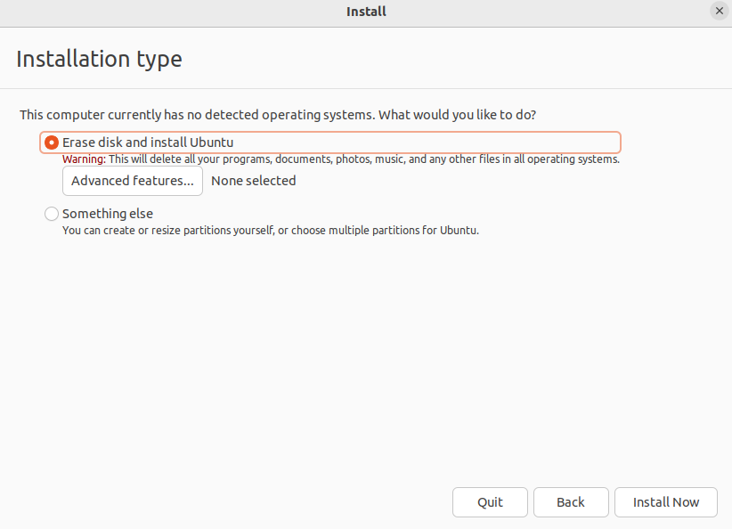
Set Environment(2/3)

Slide 16
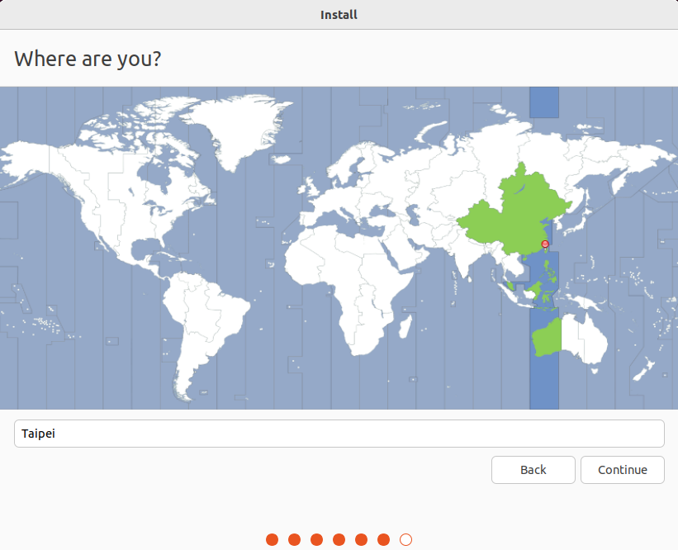
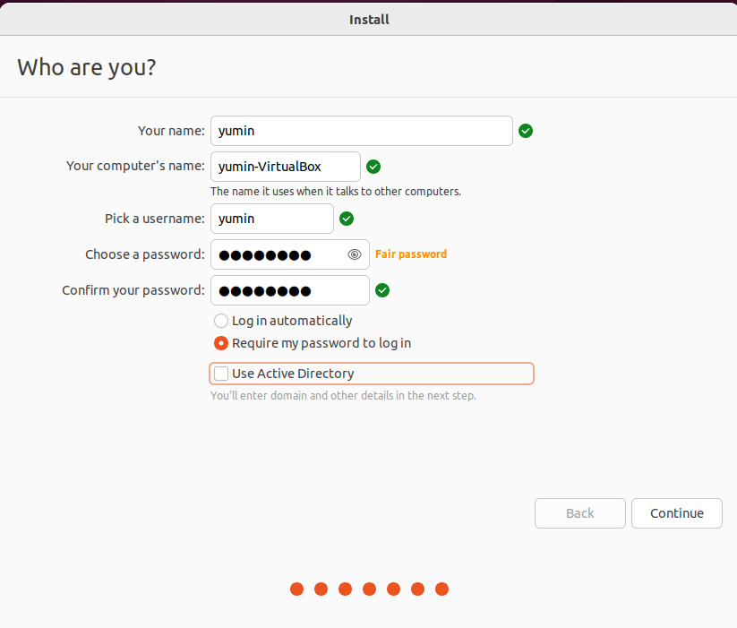
Setting Environment(3/3)

Slide 17
Implement CPLEX on Vm

Slide 18
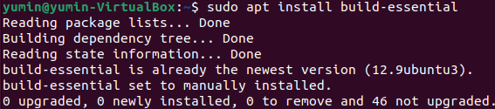
Install Package Using Terminal
Once the setting is done, open terminal.
Use command: sudo apt-get install virtualbox-guest-additions-iso
And make sure the “build-essential” package is installed already.
You need to enter password here and the word won’t display.

Slide 19
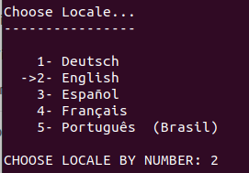
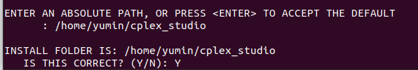
Run The .bin File in Terminal
Move the CPLEX “cplex_studio2211.linux_x86_64.bin” from windows to VM
use USB
use google drive to upload and download the files between host and VM
2
0
1
3
4
Specify the path, Modify your path to :
/home/usrname/cplex_studio

Slide 20
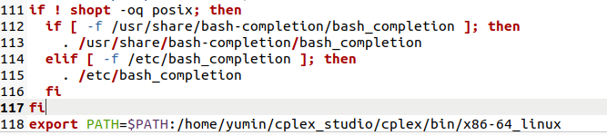
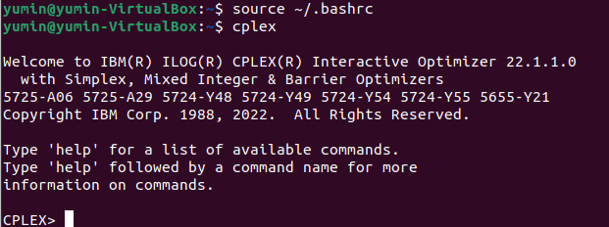
ADD Environment Path
Use command: gedit ~/.bashrc
When open the “bashrc”, add the path on the tail line.
export PATH=$PATH:/home/usrname/cplex_studio/cplex/bin/x86-64_linux
Run bashrc again and check if CPLEX is available
export PATH=$PATH:/home/usrname/cplex_studio/cplex/bin/x86-64_linux on the tail.
Type “quit” to exit the cplex system.
Notes:
由於高速應用的發展，package的 timing spec變得越來越重要，使得我們delay-matching是一個很重要的考量(也就是每個group的net的arrival time應該要一致)。
那由於之前沒有work針對advance package做delay matching，像是複雜的routing rule以及越來越嚴重的congestion，都會讓計算變得越來越複雜，所以本篇就提出了可以處理advance package delay-matching的問題。

Slide 21
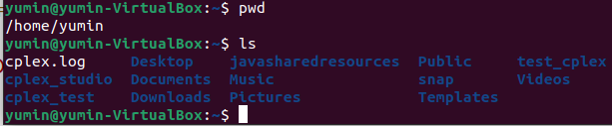
Download Simple Code and Makefile On moodle
Please put the folder “test_cplex” which is on moodle in the directory “/home/username”
If you put the folders “cplex_studio” and “cplex_test” in the wrong place, you can’t compile successfully.

Slide 22
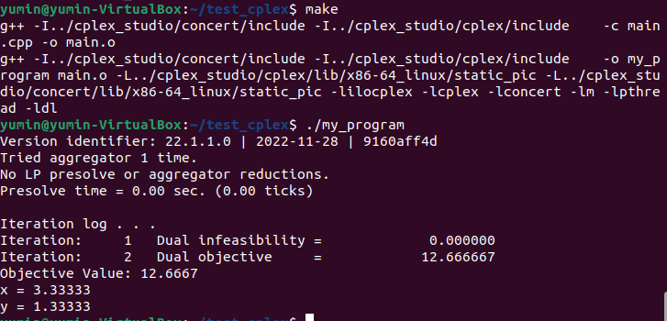
Final Result
Go to “test_cplex” directory and use command below:
Print LP result using CPLEX

